Slide 1
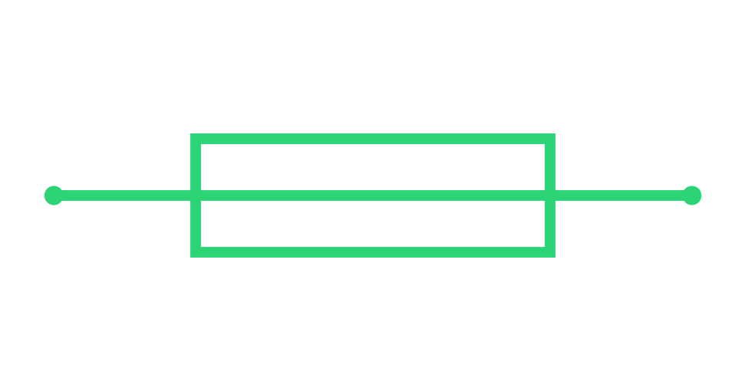
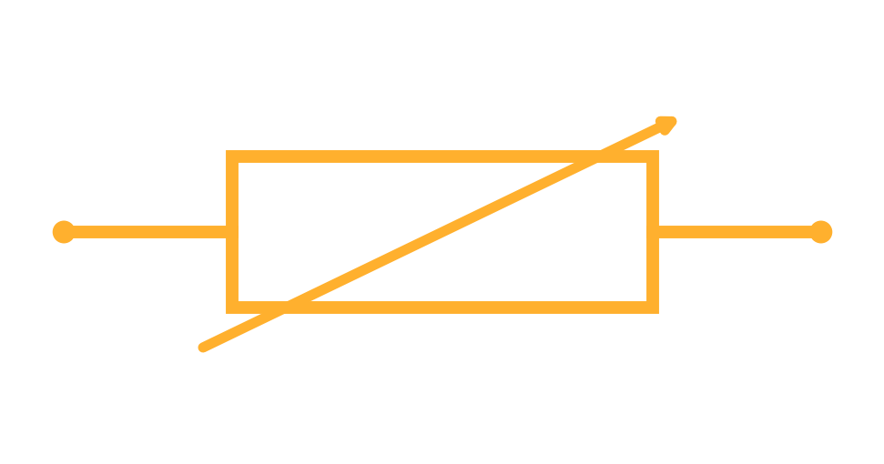
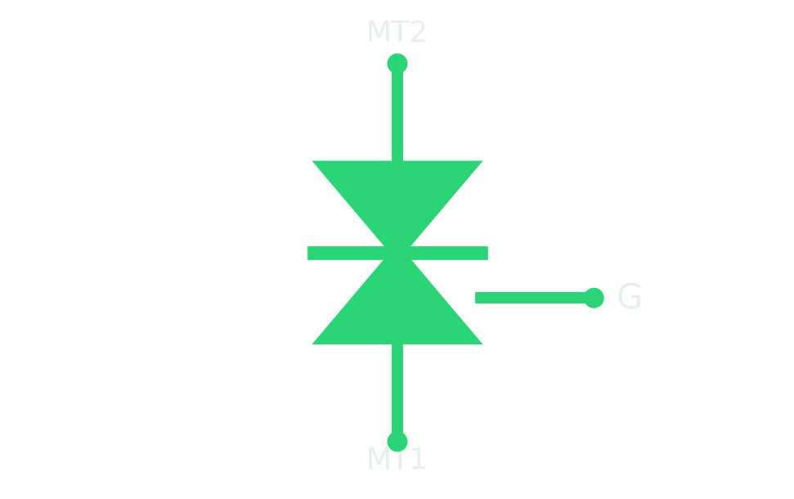
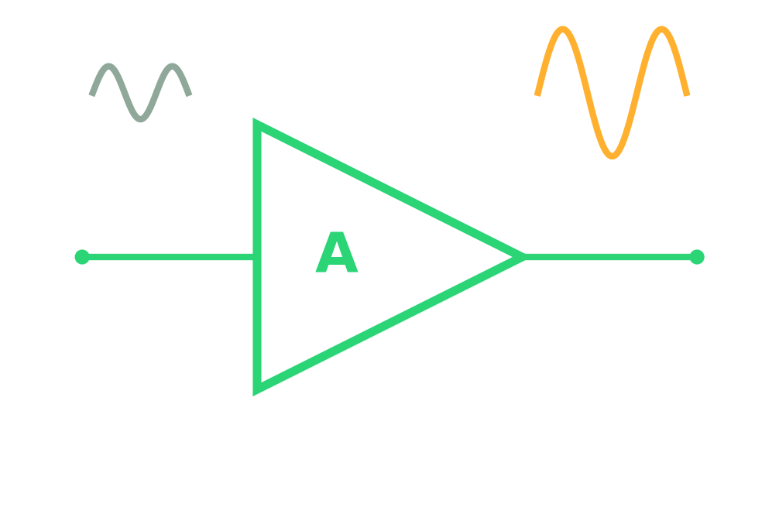
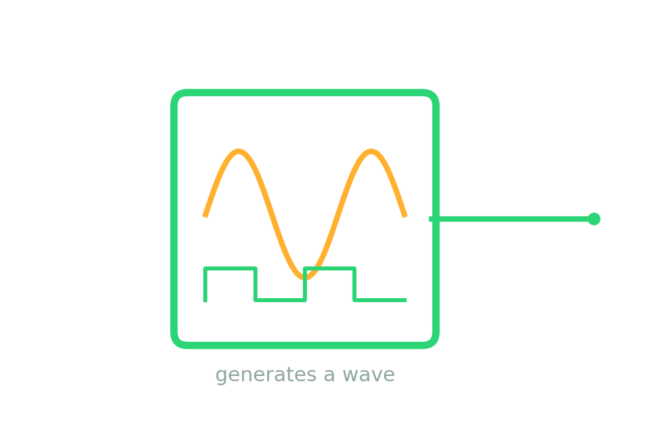
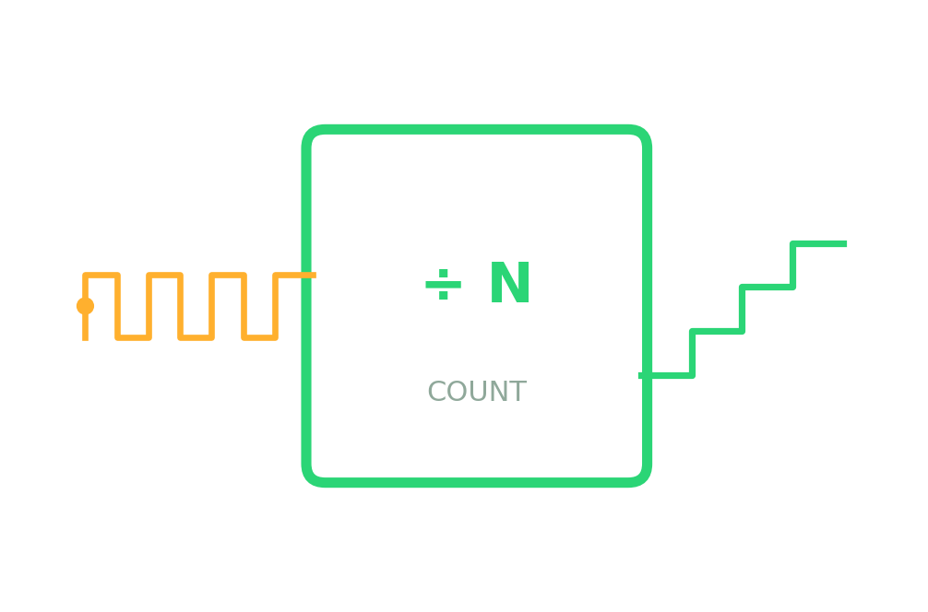
P2·00
HANDS-ON TRAINING · PART 2
Protection &
Signal Devices
The parts that keep circuits safe — and the building blocks that shape, generate and count signals.
FUSE
VARISTOR
TRIAC
AMPLIFIER
OSCILLATOR
COUNTER

Slide 2
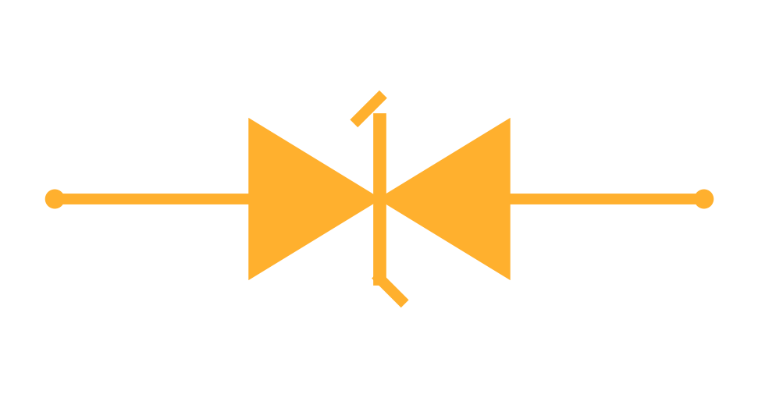
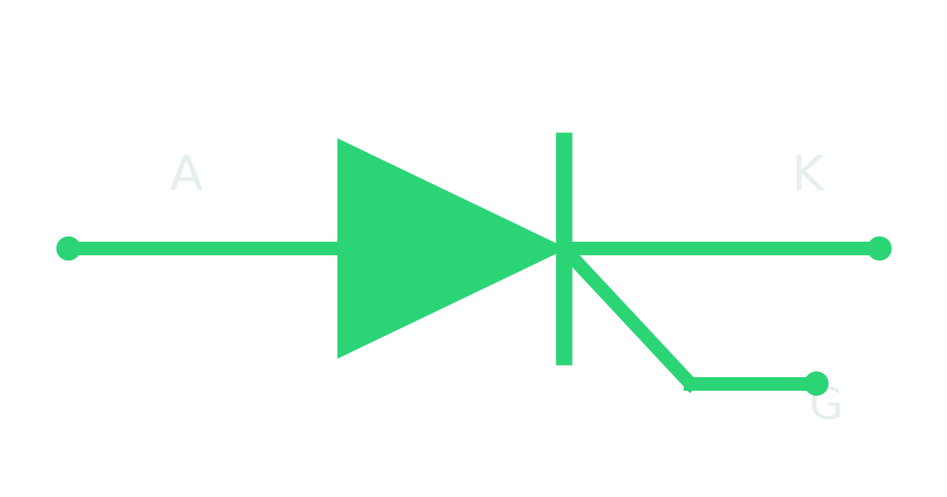

P2·A
MODULE A · PROTECTION & POWER-CONTROL
The Safety & Switching Devices
Parts that guard a circuit from too much current or voltage — and switch AC/DC power.
Fuse
Varistor
TVS diode
SCR
TRIAC
DIAC
Breaks on overcurrent
Clamps voltage surges
Clamps fast spikes
Latching DC switch
AC power switch
Triggers a TRIAC
Amps (A)
V clamp
V
Gate
Gate
V break

Slide 3
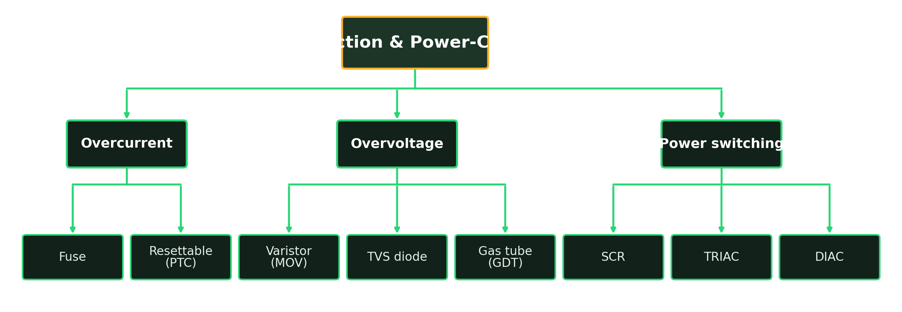
P2·A
MODULE A · PROTECTION
Types of Protection & Control Device
Split by the job: stop too much current, clamp too much voltage, or switch power.
HOW IT SPLITS Overcurrent breaks the circuit; overvoltage diverts the surge; thyristors switch the load.

Slide 4
P2·A
MODULE A · PROTECTION
Protection Devices — Build, Purpose & Use
Guarding against overcurrent and overvoltage.
TYPE
HOW IT'S BUILT
PURPOSE
EXAMPLE USE
Fuse
Thin wire in a glass/ceramic body
Break circuit on overcurrent
Mains inlet, PSU primary
Resettable PTC
Polymer that turns high-R when hot
Self-resetting current limit
USB ports, battery packs
Varistor (MOV)
Zinc-oxide disc, voltage-dependent
Clamp mains voltage surges
Across L-N at the input
TVS diode
Fast avalanche junction
Clamp fast transient spikes
Data lines, ports, ESD
Gas tube (GDT)
Sealed gas gap between electrodes
Divert big surges to earth
Telecom & mains surge

Slide 5
P2·A
MODULE A · POWER-CONTROL
Power-Control — Build, Purpose & Use
The thyristor family — switching real power from a small trigger.
TYPE
HOW IT'S BUILT
PURPOSE
EXAMPLE USE
SCR
Four-layer PNPN latch, gate-fired
Switch & latch DC power
Crowbar, DC control, chargers
TRIAC
Two SCRs back-to-back in one part
Switch AC in both directions
Lamp dimmers, motor/heater control
DIAC
Symmetrical breakover trigger device
Fire a TRIAC's gate cleanly
Trigger stage in dimmers

Slide 6
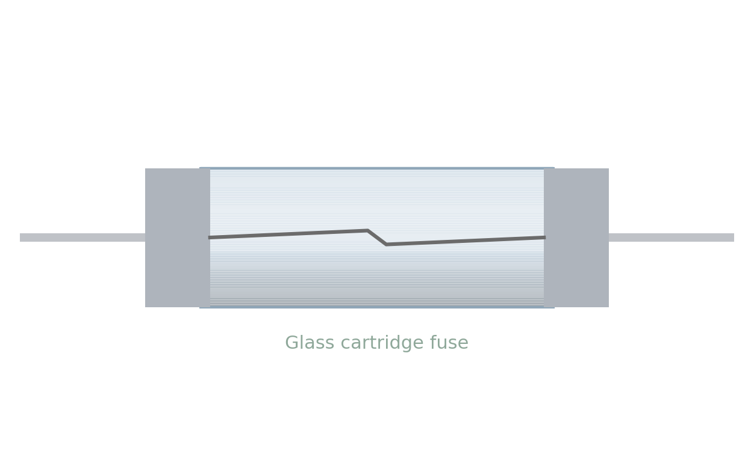
P2·A
MODULE A · SPOTLIGHT
Fuse
A deliberate weak link that sacrifices itself to save the circuit.
What it is
A thin wire that melts and breaks the circuit when current gets too high.
What it does
Protects wiring and everything downstream from overcurrent and shorts.
Identify
Glass/ceramic cartridge or blade; marked in amps + volts, fast (F) or slow (T).
Schematic symbol
Test & fails
Continuity: good = beep (~0Ω), blown = open. Always replace with the same rating.

Slide 7
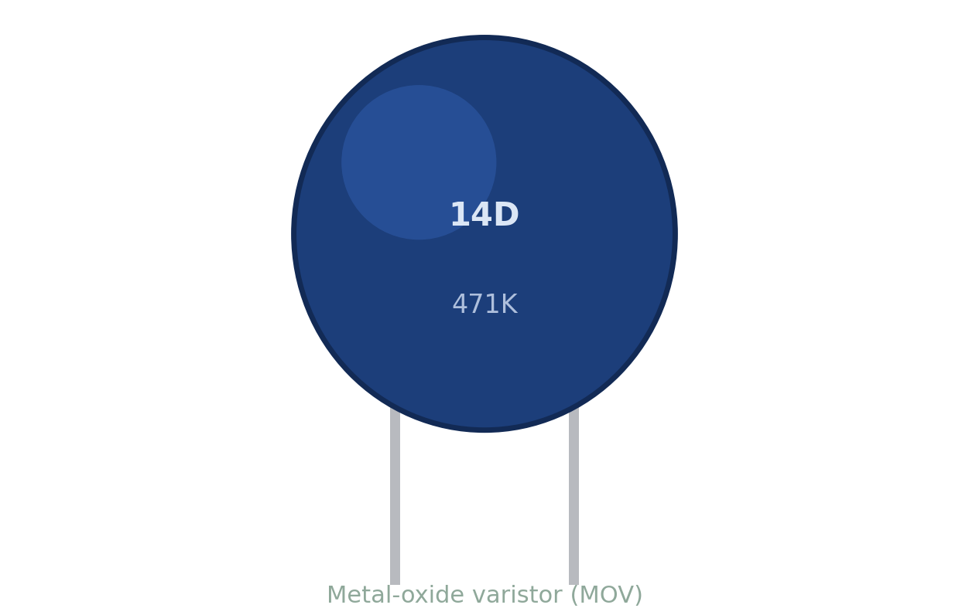
P2·A
MODULE A · SPOTLIGHT
Varistor (MOV)
A voltage-triggered shock-absorber for the mains.
What it is
A voltage-dependent resistor: near-infinite normally, it collapses above its clamp voltage.
What it does
Shunts surge energy (lightning, switching spikes) safely across the input.
Identify
Blue/orange disc marked with a clamp code, e.g. 14D471K ≈ 470 V.
Schematic symbol
Test & fails
Ω reads very high/open when good. Fails shorted, or cracked and charred after big surges.

Slide 8
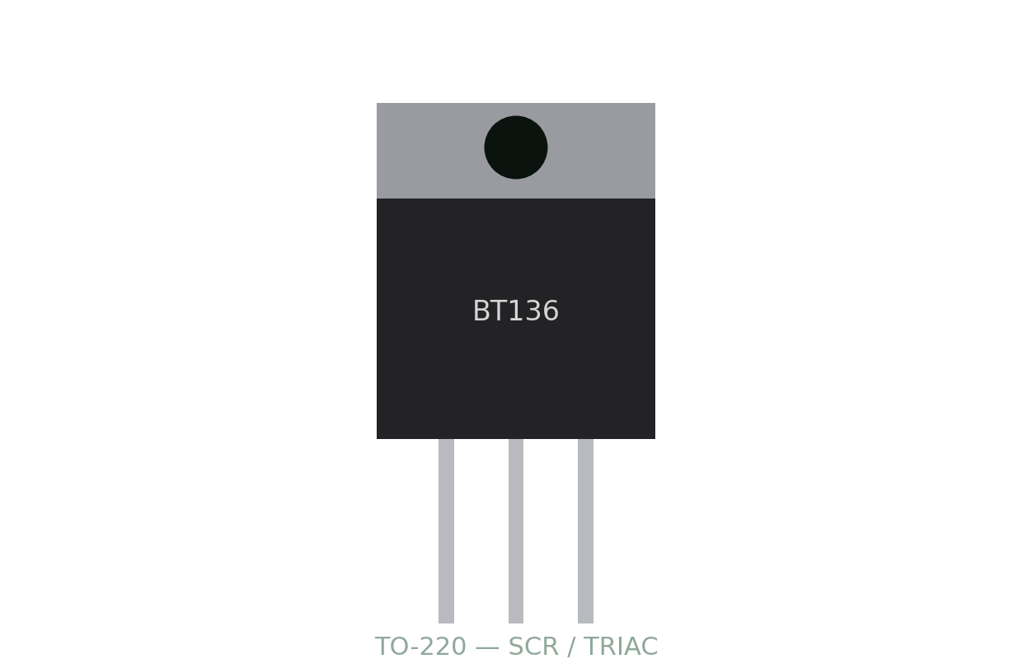
P2·A
MODULE A · SPOTLIGHT
SCR (Thyristor)
A one-way switch that latches ON until the current stops.
What it is
A gate pulse turns it on; it stays on until the current through it drops to zero.
What it does
Switches large DC currents from a tiny gate signal; used in crowbar protection.
Identify
Three leads A-K-G, often TO-220 (TIC106, BT151).
Schematic symbol
Test & fails
Diode mode A-K reads open both ways; a gate pulse latches it. Fails shorted (stuck on).

Slide 9
P2·A
MODULE A · SPOTLIGHT
TRIAC
A two-way SCR that switches AC on both halves of the wave.
What it is
Like two SCRs back-to-back; triggered by either gate polarity, it conducts both AC directions.
What it does
Controls AC power — lamp dimmers, fan/motor speed, heater control.
Identify
Three leads MT1-MT2-G, TO-220 (BT136). Usually fired by a DIAC.
Schematic symbol
Test & fails
MT1-MT2 open until gated. Fails shorted → the load is stuck full-on (a classic dimmer fault).

Slide 10
P2·A
MODULE A · BENCH REFERENCE
Testing Protection & Power Devices
One line per device — the meter setting, a healthy reading, and a faulty one.
DEVICE
METER SETTING
GOOD READING
BAD READING
Fuse
Continuity
Beep, ~0 Ω
Open / OL
Varistor (MOV)
Ohms (Ω)
Very high / open
Shorted, or charred
TVS diode
Diode mode
Diode-like one way
Shorted or leaky
SCR
Diode mode
A-K open both ways
Shorted (stuck on)
TRIAC
Diode mode
MT1-MT2 open
Shorted (load stuck on)
DIAC
Ohms (Ω)
Open both ways
Shorted or open

Slide 11
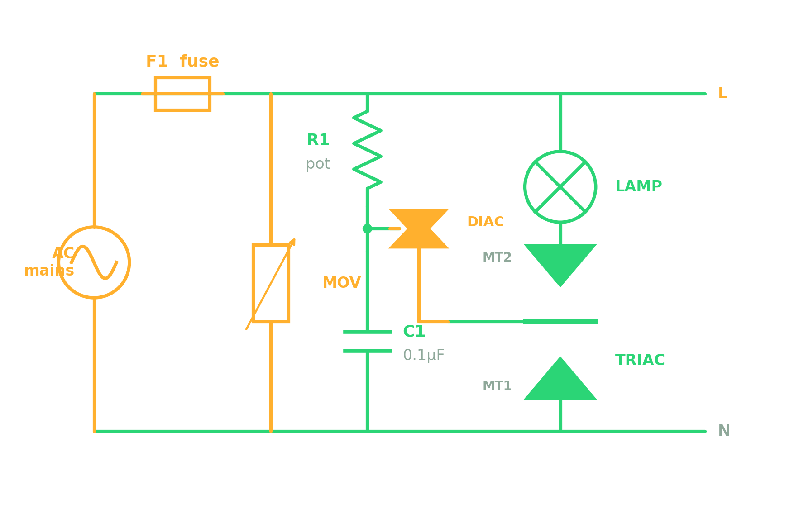
P2·A
MODULE A · PROJECT
TRIAC Lamp Dimmer
Phase-control dimming — the TRIAC fires later each half-cycle to lower the brightness.
MAINS · CARE
YOU'LL BUILD
Fuse + holder, MOV (275V), TRIAC (BT136), DIAC (DB3), 250k pot, 0.1µF/400V film cap, lamp.
BUILD & SOLDER
1 Fuse and MOV go across the incoming mains.
2 Build the R-C network; DIAC feeds the gate.
3 TRIAC sits in series with the lamp.
Read the schematic before you solder
MEASURE & VERIFY
COMPONENTS USED
Lamp brightness changes as you turn the pot.
Scope: the firing point shifts along the wave.
⚠ Live mains — instructor supervision only.
Fuse · Varistor · TRIAC · DIAC · R · Capacitor

Slide 12
P2·A
MODULE A · PROJECT
TRIAC Dimmer — Why It Works
Why the R-C sets the brightness, how the DIAC triggers, and what each fault does.
WORKING OUT THE NUMBERS
Firing angle set by R·C: bigger R or C = later firing = dimmer lamp
DIAC breaks over at ~30 V and delivers one sharp gate pulse to the TRIAC
Verify: turn the pot — the TRIAC fires later each half-cycle, so the lamp dims.
PART
WHY IT'S PLACED HERE
IF MISSING OR BROKEN
Fuse
First line of defence on the incoming live wire.
Blown/removed: no overcurrent protection — a fault risks a fire.
Varistor (MOV)
Across L-N to clamp incoming surges.
Missing: a spike can punch through and destroy the TRIAC.
R (pot) + C
Set the phase delay before the gate fires.
R open: TRIAC never fires (dark). R shorted: full brightness only.
DIAC
Fires the gate sharply at a set voltage.
Missing/faulty: erratic triggering, flicker, or no dimming.
TRIAC
The AC switch feeding the lamp.
Shorted: lamp stuck full-on. Open: lamp stays dead.

Slide 13
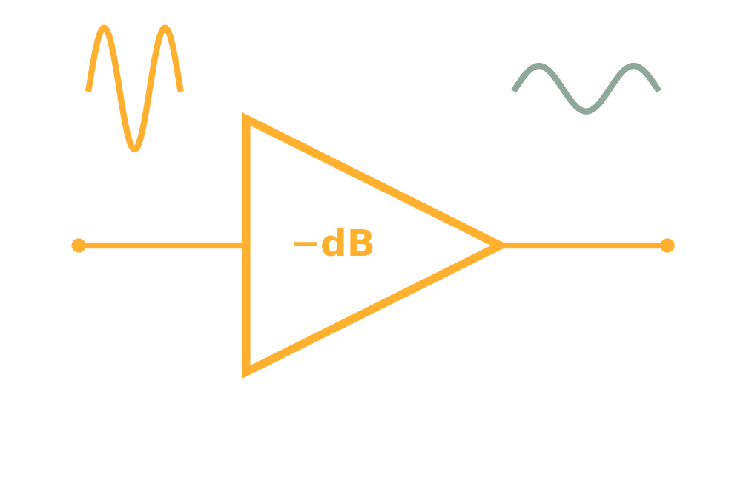
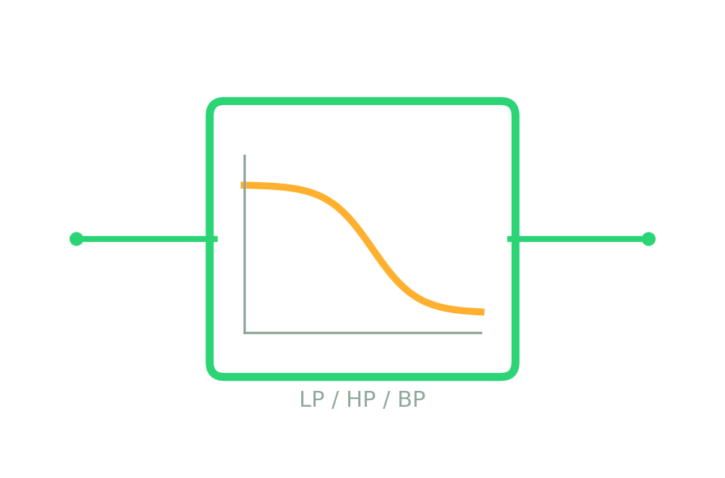
P2·B
MODULE B · ADDITIONAL COMPONENTS
The Signal Building Blocks
Functional blocks that shape, generate and count signals between the basic parts.
Amplifier
Attenuator
Filter
Oscillator
Counter
Boosts a signal
Reduces a signal
Selects frequencies
Generates a wave
Counts & divides
Gain > 1
Gain < 1 (dB)
LP / HP / BP
Hz → MHz
÷ N

Slide 14
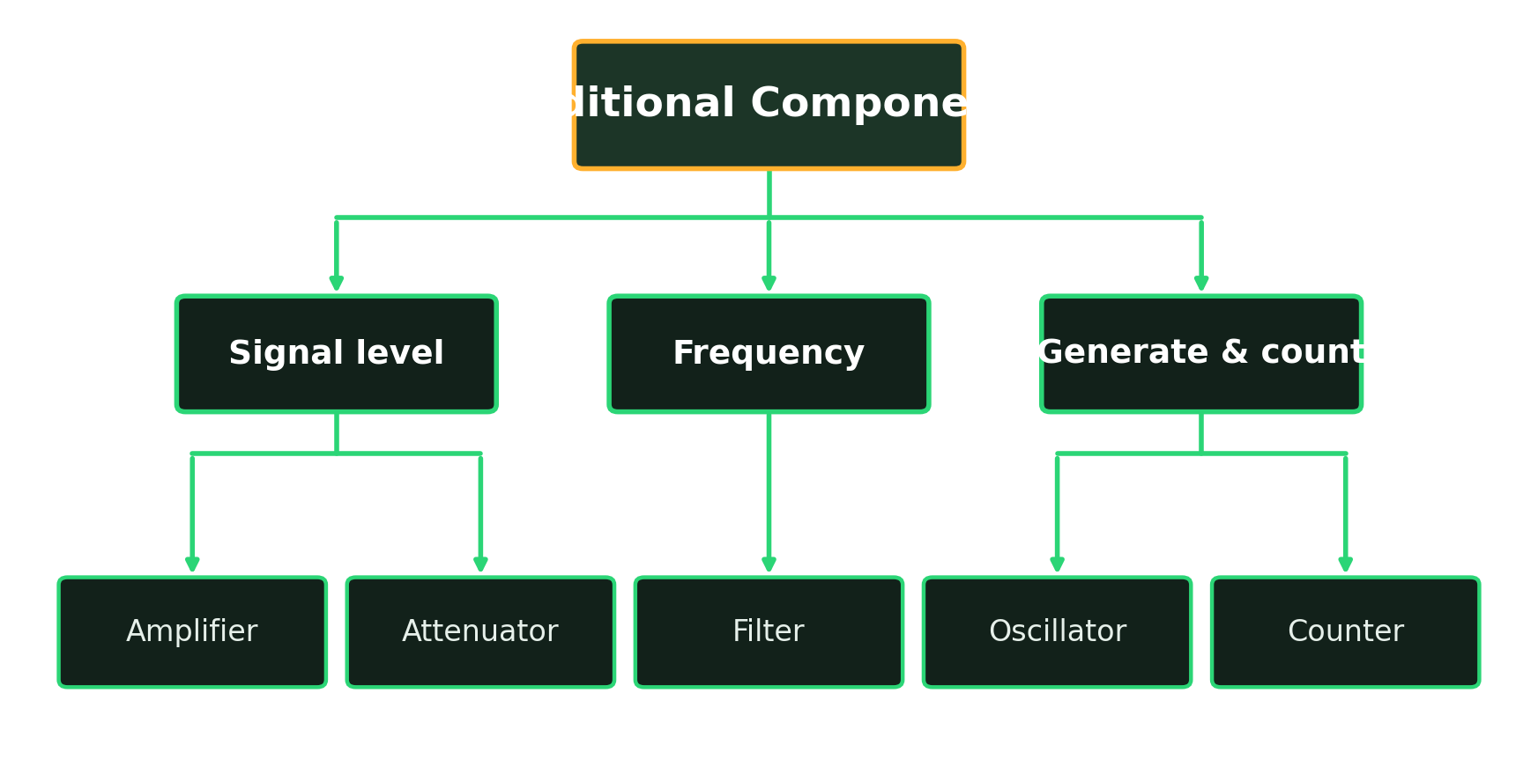
P2·B
MODULE B · ADDITIONAL COMPONENTS
Types of Signal Block
Grouped by what they do to a signal: change its level, shape its frequency, or generate and count it.
HOW IT SPLITS Level blocks scale a signal; frequency blocks shape it; timing blocks make and count waves.

Slide 15
P2·B
MODULE B · ADDITIONAL COMPONENTS
Signal Blocks — Build, Purpose & Use
What each block is made from, what it's for, and where you'll meet it.
TYPE
HOW IT'S BUILT
PURPOSE
EXAMPLE USE
Amplifier
Op-amp or transistor + feedback
Increase signal level (gain > 1)
Mic preamp, audio, sensor front-end
Attenuator
Resistor divider / pad network
Reduce signal level (gain < 1)
Protect ADC & RF inputs
Filter
R-C, L-C, or active op-amp stage
Pass or block by frequency
Anti-alias, tone, noise removal
Oscillator
RC, LC, crystal, or a 555 timer
Generate a repeating waveform
Clocks, tones, RF carriers
Counter
Chained flip-flops (e.g. 4017)
Count pulses, divide by N
Clocks, sequencers, LED chasers

Slide 16
P2·B
MODULE B · SPOTLIGHT
Amplifier
A block that makes a signal bigger — a scaled-up copy of the input.
What it is
Output is the input multiplied by the gain (gain > 1).
What it does
Boosts weak signals — mic, sensor, antenna — up to a usable level.
Built from
Op-amps or transistors; feedback resistors set the exact gain.
In use / test
Small in → big out
Gain = Vout ÷ Vin. Classes A/B/AB/D trade heat against efficiency.

Slide 17
P2·B
MODULE B · SPOTLIGHT
Attenuator
The opposite of an amplifier — it turns a signal down on purpose.
What it is
Scales a signal down (gain < 1), measured in decibels (dB).
What it does
Matches levels between stages and protects sensitive inputs.
Built from
A simple resistor divider (pad) — fixed or switched.
In use / test
Big in → small out
Loss(dB) = 20·log(Vout ÷ Vin). Sits before ADCs and RF front-ends.

Slide 18
P2·B
MODULE B · SPOTLIGHT
Filter
A frequency gatekeeper — it passes some frequencies and blocks others.
What it is
Passes a chosen band: low-pass, high-pass, band-pass or notch.
What it does
Cleans signals — removes noise, hum, or unwanted tones.
Built from
R-C or L-C networks (passive), or op-amps (active).
In use / test
Passes a chosen band
Cut-off fc = 1 ÷ (2πRC). Sweep frequency and watch the output roll off.

Slide 19
P2·B
MODULE B · SPOTLIGHT
Oscillator
A signal generator — it makes a repeating waveform all by itself.
What it is
Produces a sine, square or triangle wave with no input signal.
What it does
Creates clocks, tones and carriers for the rest of the circuit.
Built from
RC, LC, crystal, or a 555 timer; feedback keeps it swinging.
In use / test
Generates a waveform
Frequency set by R-C or the crystal. Measure with a scope or counter.

Slide 20
P2·B
MODULE B · SPOTLIGHT
Counter
A digital tally — it counts pulses and divides a frequency down.
What it is
Advances a count on every incoming clock pulse.
What it does
Counts events, sequences outputs, and divides clocks (÷N).
Built from
Chained flip-flops (e.g. 4017 decade, 4026, 7490).
In use / test
Counts & divides pulses
Feed a clock; each pulse steps the count. Output frequency = input ÷ N.

Slide 21
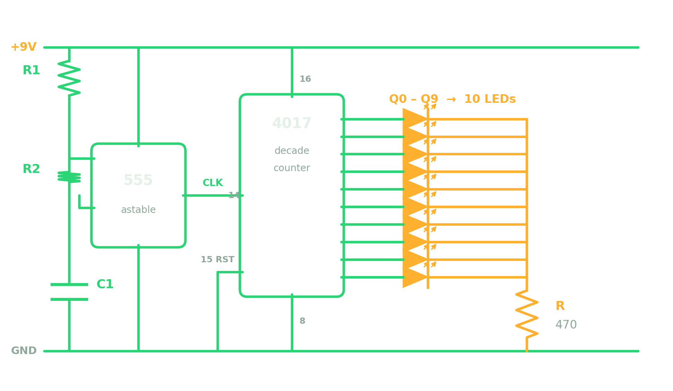
P2·B
MODULE B · PROJECT
555 + 4017 LED Chaser
An oscillator clocks a counter — a running light that steps across ten LEDs.
BEGINNER+ · 1.5 HR
YOU'LL BUILD
555 + 8-pin socket, 4017 + 16-pin socket, R1 10k, R2 100k, C1 10µF, 10 LEDs, R 470, 9V.
BUILD & SOLDER
1 Solder both IC sockets first.
2 Wire the 555 astable; its output to 4017 pin 14 (CLK).
3 Fan the ten LEDs from Q0-Q9 through one 470Ω.
Read the schematic before you solder
MEASURE & VERIFY
COMPONENTS USED
The lit LED steps along, one per clock pulse.
Step rate = the 555's clock frequency.
Bigger C1 slows the chase so you see each step.
Oscillator (555) · Counter (4017) · LEDs · Resistor

Slide 22
P2·B
MODULE B · PROJECT
LED Chaser — Why It Works
Why the 555 sets the speed, how the 4017 steps, and what breaks the chase.
WORKING OUT THE NUMBERS
555 clock: f = 1.44 ÷ ((R1 + 2·R2)·C1) — this sets the chase speed
4017 lights one of Q0–Q9 per clock pulse, then wraps around (÷10)
Verify: 10 steps = one full loop; a bigger C1 slows the chase down.
PART
WHY IT'S PLACED HERE
IF MISSING OR BROKEN
555 (oscillator)
Generates the clock that drives the chase.
Dead/no clock: the 4017 never advances, one LED stuck on.
R1 + R2 + C1
Set the 555's clock speed.
Open: no clock at all. Wrong values: chase too fast or slow.
4017 (counter)
Steps the lit output on each clock pulse.
Dead: no stepping. Reset stuck high: only Q0 ever lights.
10 LEDs + R
Show the count; R limits their current.
R open: LEDs dark. An LED reversed: that step simply skips.

Slide 23
P2·00
MODULE WRAP-UP · PART 2
You Can Now…
By the end of Part 2, every recruit should be able to:
Pick the right device for overcurrent vs overvoltage protection
✓
!
Read and test fuses, MOVs, SCRs and TRIACs on the bench
✓
GOLDEN RULE
Mains circuits like the dimmer are for supervised, isolated-bench work only.
Recognise the signal blocks: amplify, attenuate, filter, oscillate, count
✓
Build an AC dimmer and a 555+4017 LED chaser from a schematic
✓

